Slide 1
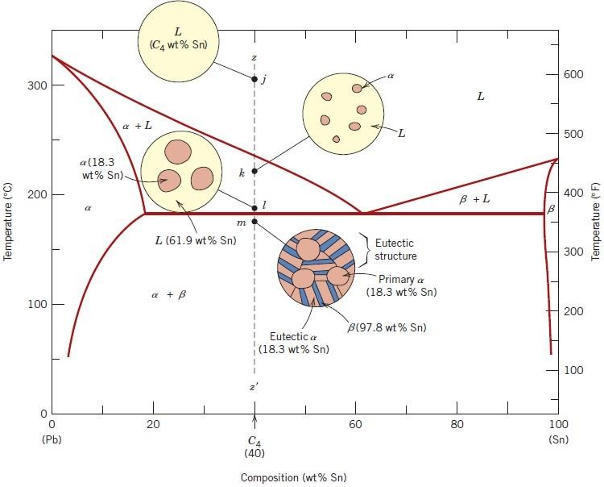
Figure 12 Schematic representations of the equilibrium microstructures for a
lead–tin alloy of composition C₄ as it is cooled from the liquid-phase region.
It is possible to compute the relative amounts of both eutectic and primary α
microconstituents. Because the eutectic microconstituent always forms from the
liquid having the eutectic composition, this microconstituent may be assumed to
have a composition of 61.9 wt% Sn. Hence, the lever rule is applied using a tie line
between the α–( α+β) phase boundary (18.3 wt% Sn) and the eutectic composition.
For example, consider the alloy of composition C´4 in Figure 14. The fraction of
1

Slide 2








the eutectic microconstituent We is just the same as the fraction of liquid WL from
which it transforms, or
Furthermore, the fraction of primary α, Wα, is just the fraction of the α phase that
existed prior to the eutectic transformation or, from Figure 14,
The fractions of total α, Wα (both eutectic and primary), and also of total β, Wβ, are
determined by use of the lever rule and a tie line that extends entirely across the
α+β phase field. Again, for an alloy having composition C´4,
Analogous
transformations and
microstructures
result
for alloys
having
compositions to the right of the eutectic (i.e., between 61.9 and 97.8 wt% Sn).
However, below the eutectic temperature, the microstructure will consist of the
eutectic and primary β microconstituents because, upon cooling from the liquid, we
pass through the β+liquid phase field.
2

Slide 3
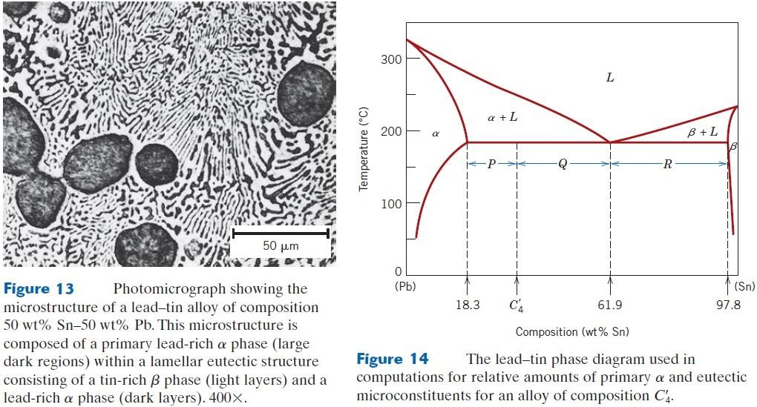
Nonequilibrium Solidification:
For the fourth case represented in Figure 12, when conditions of equilibrium are
not maintained while passing through the α (or β) + liquid phase region, the
following consequences will be realized for the microstructure upon crossing the
eutectic isotherm: (1) grains of the primary microconstituent will be cored, that is,
have a nonuniform distribution of solute across the grains, and (2) the fraction of
the eutectic microconstituent formed will be greater than for the equilibrium
situation.
3

Slide 4
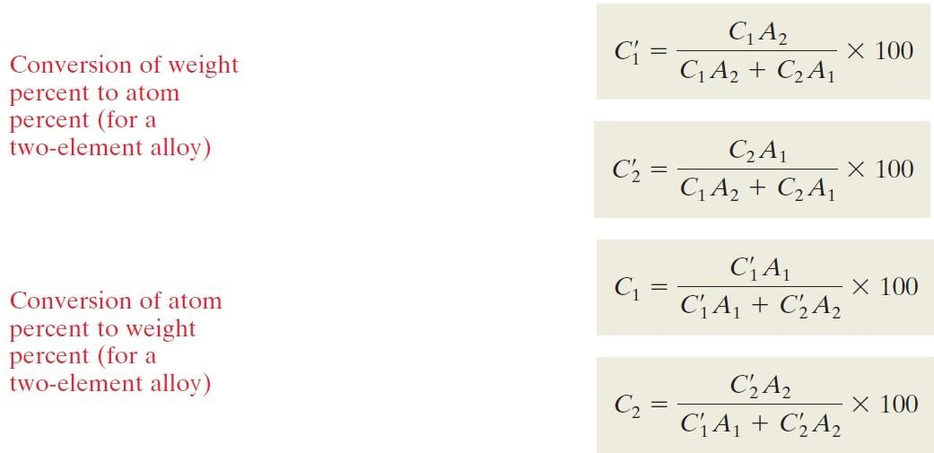
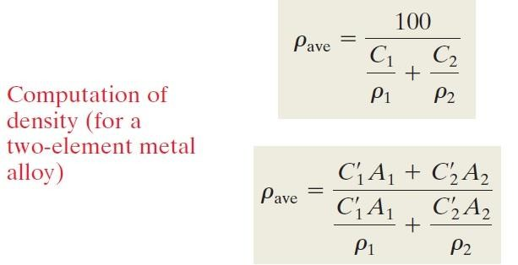
Composition Conversions
Sometimes it is necessary to convert from one composition scheme to another—for
example, from weight percent to atom percent. We will now present equations for making these conversions in terms of the two elements (1) and (2). Considering
weight percents denoted by C1 and C2, atom percents by
and
, and
atomic
weights as A1 and A2), we express these conversion expressions as follows:
4

Slide 5
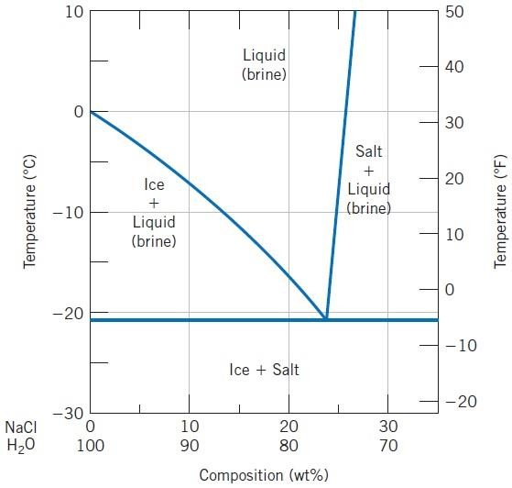
Concept Check: At 700°C, what is the maximum solubility (a) of Cu in Ag? (b)
Of Ag in Cu?
Concept Check: The following is a portion of the H2O–NaCl phase diagram:
(a) Using this diagram, briefly explain how spreading salt on ice that is at a
temperature below 0°C can cause the ice to melt. (b) At what temperature is salt no longer useful in causing ice to melt?
5

Slide 6
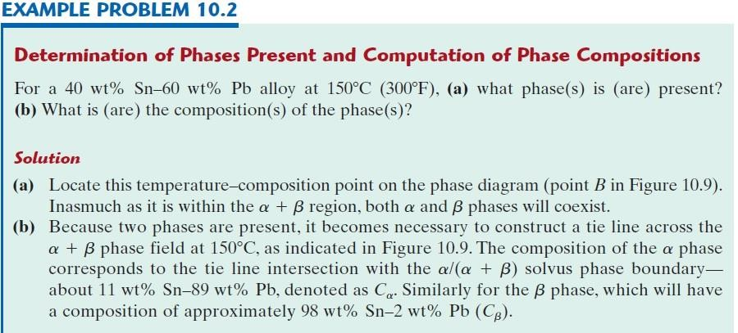
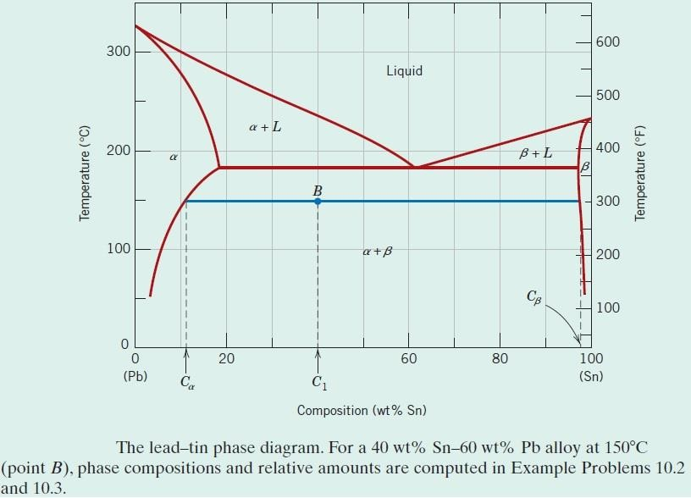
6

Slide 7
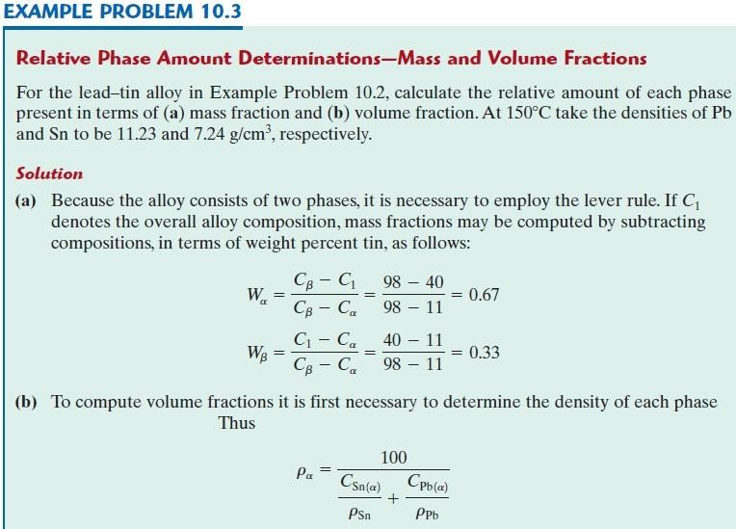
7

Slide 8
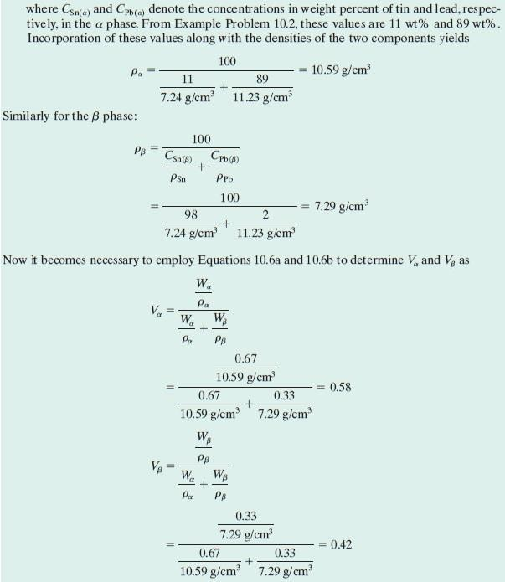
8

